Slide 1
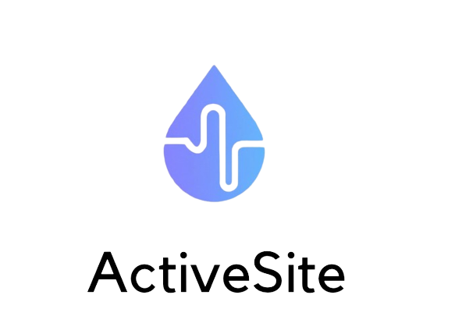

“Empower your health with Active Site's continuous monitoring.”

Slide 2
DOMAIN OF THE PROJECT
Artificial Intelligence for the detection of glucose, hydration, and other nutritional and health items with continuous monitoring from a sensor
Why it's a new project?
Health in one single site
Affordable and accessible
Learns from the user
No need to manually input info. each time

Slide 3
TABLE OF CONTENTS
01
02
03
04
LIST OF OBJECTIVES
DATA PROCESSING
Target users and main functionalities
Information to be extracted & architecture to be implemented
EXPECTATIONS
INTERACTIONS
Expected inputs and outputs
Summary of interactions

Slide 4
01
LIST OF OBJECTIVES
Target users and main functionalities

Slide 5

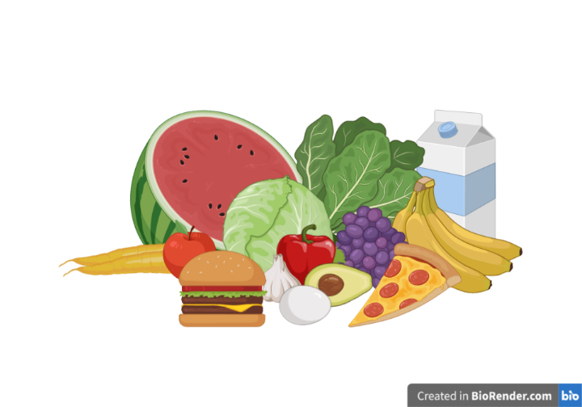
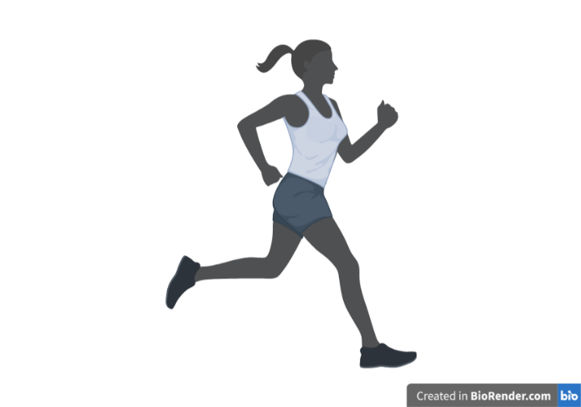
TARGET USERS
LIFESTYLE
People interested in monitoring their nutrition and health on a continuous basis
HEALTH
People with specific dietary or health goals that require ongoing monitoring and tracking
FITNESS
Athletes, fitness and active people who want to optimize their performance and recovery
HOW USERS WILL INTERACT WITH THE SYSTEM?
- Pain free sticker-like sensor that connects using Bluetooth to connect to the app
- Application for Android and iOS that can be used in different languages

Slide 6
MAIN FUNCTIONALITIES
Continuous monitoring of different nutritional and health indicators using a sensor (sticker-like) attached to the skin.
Possibility to integrate with other apps or platforms to provide a more complete picture of the user's health and wellness.
Real-time data analysis and tracking using AI algorithms to provide personalized recommendations and insights.

Slide 7
02
DATA PROCESSING
Information to be extracted & architecture to be implemented

Slide 8
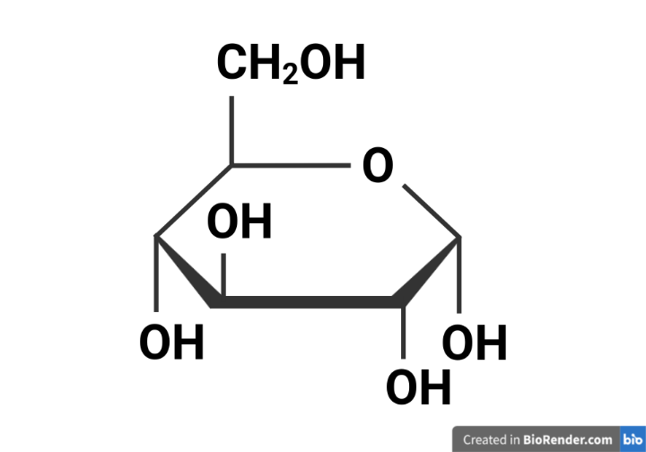


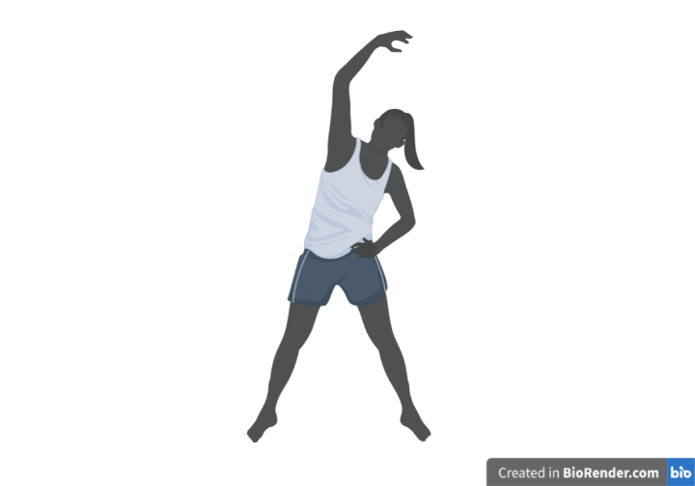


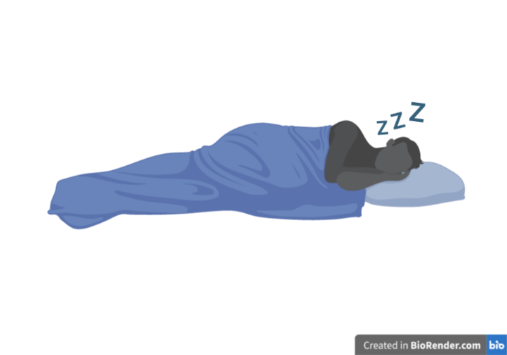
INFORMATION TO BE EXTRACTED

Slide 9

ARCHITECTURE TO BE IMPLEMENTED
Data collection: manual input, site’s data
Data processing using AI
User interface: application
Integration with external systems
Security and privacy: encryption of data

Slide 10
03
EXPECTATIONS
Expected inputs and outputs

Slide 11
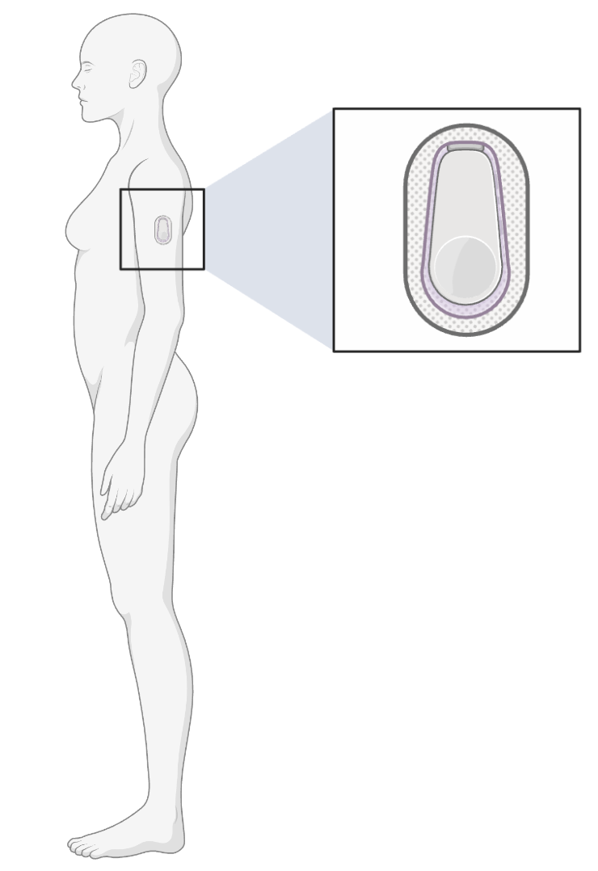
EXPECTED INPUTS
All the information needed to measure the levels required depending on the mode that the user has selected at the beginning.
User’s
Site’s

Slide 12
EXPECTED OUTPUTS
Real-time monitoring of different parameters.
Personalized recommendations and insights based on real-time data analysis and machine learning algorithms.
Customizable settings and alerts to notify users of any deviations from their goals or target ranges.
Data visualization and reporting to help users track their progress.
Integration with other health and fitness apps to provide a comprehensive view of overall health and wellness.

Slide 13
04
INTERACTIONS
Summary of interactions

Slide 14
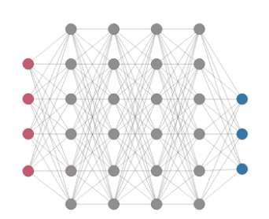
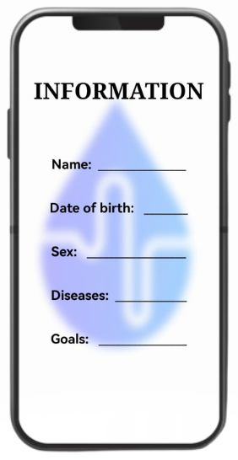
SUMMARY OF INTERACTIONS
Account: personal information (name, date of birth, sex, diseases, etc.) and goals
Name of the person who is using it
Date of birth and sex: male or female
Diseases: previous knowledge of the person
Goals: reason why is getting this software

Slide 15
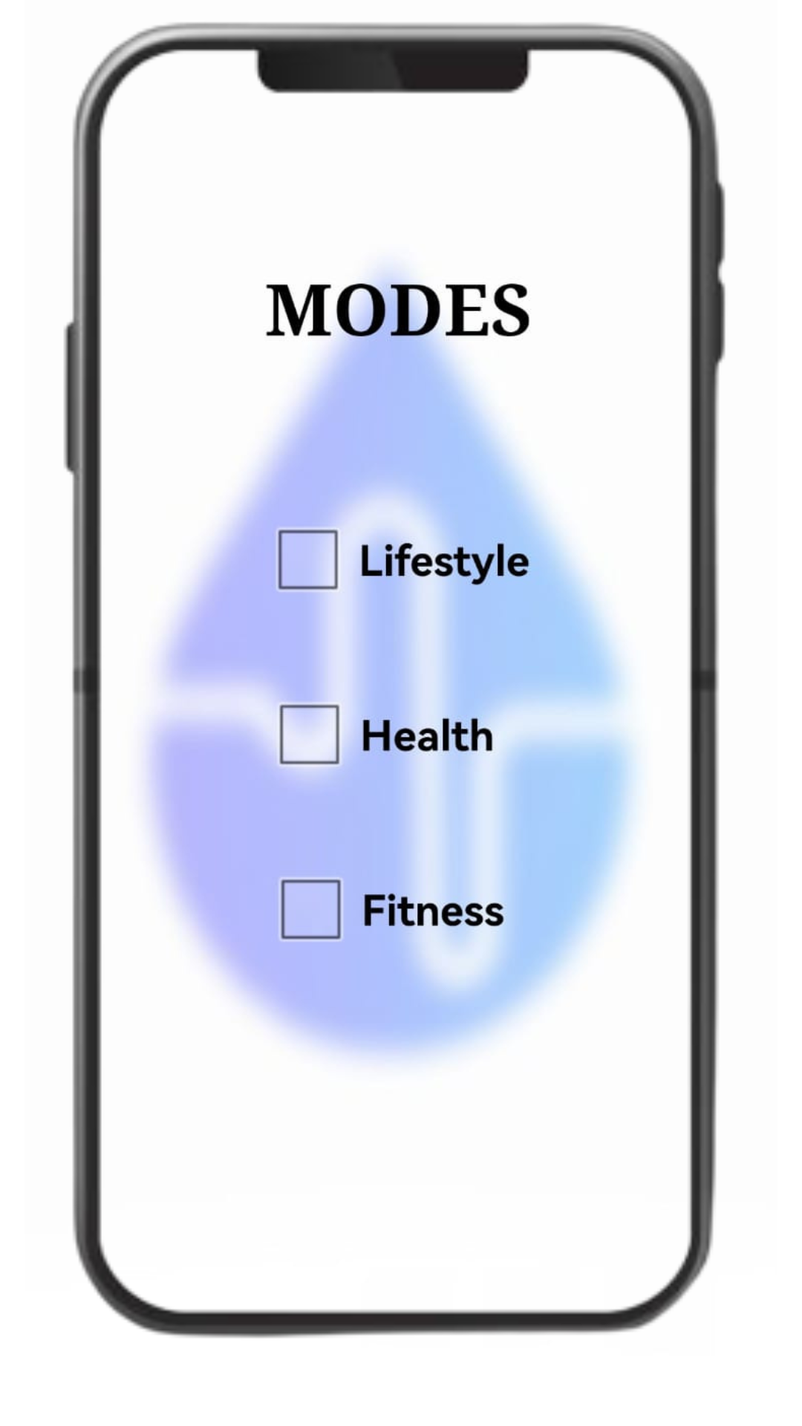
SUMMARY OF INTERACTIONS
Select a mode on the app (lifestyle, health, or fitness)
Shared information: name, age, sex, diseases
Lifestyle: weight, height, objectives
Health: emergency contacts, diet, allergies, medication
Fitness: physical activity, diet, objectives

Slide 16
SUMMARY OF INTERACTIONS
Pain free sticker-like site on skin
The person gets a pain free sticker-like site on skin
Connected to the phone by Bluetooth
From it, we will obtain all the information

Slide 17
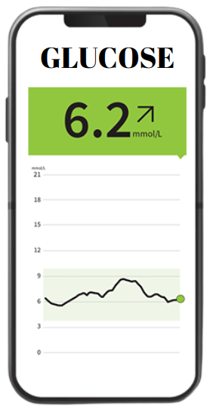
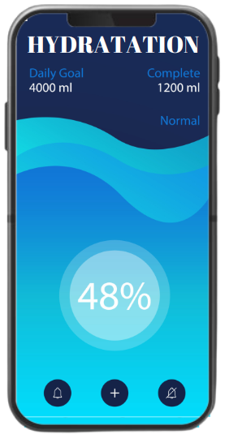
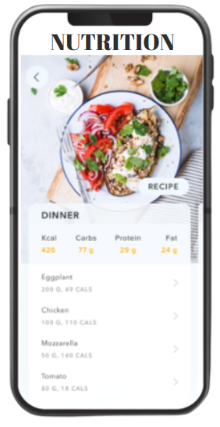

SUMMARY OF INTERACTIONS
Continuous monitoring, providing alerts when levels fall outside a user's target range

Slide 18
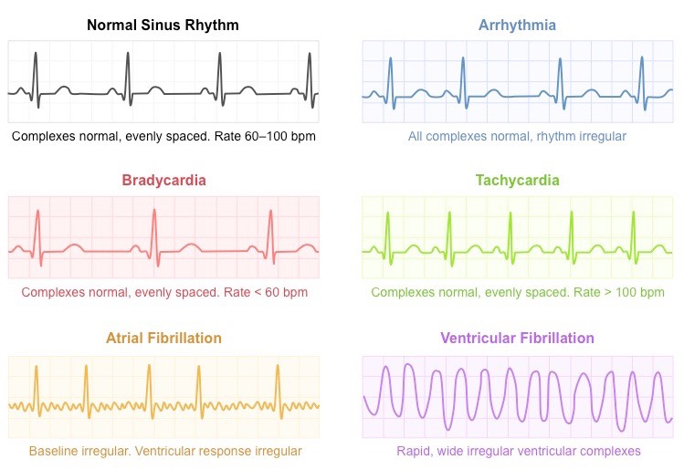
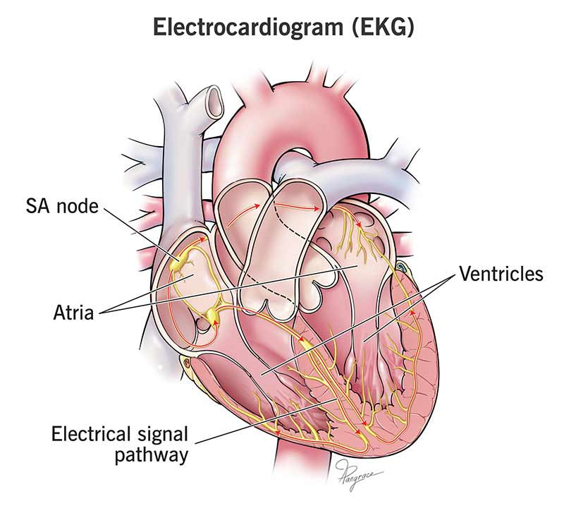
SUMMARY OF INTERACTIONS
Machine learning algorithms: analyze data and provide personalized recommendations

Slide 19

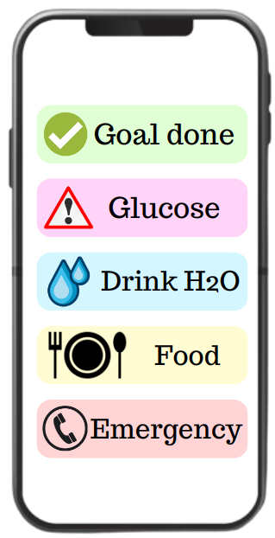
SUMMARY OF INTERACTIONS
Customizable settings and alerts to notify users of any deviations

Slide 20
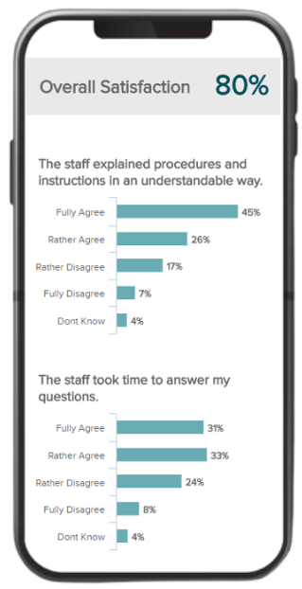
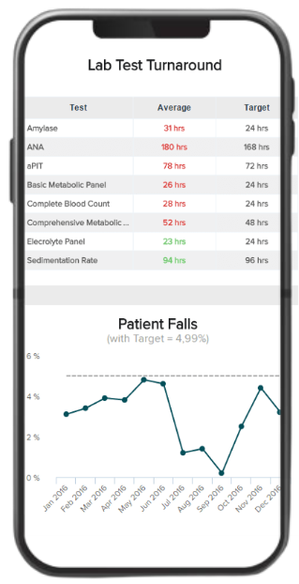
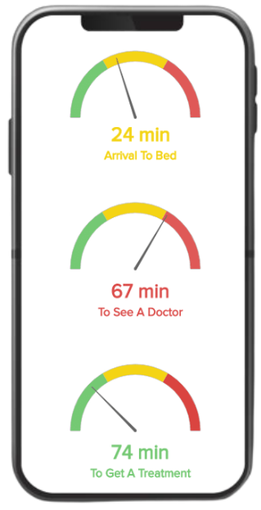

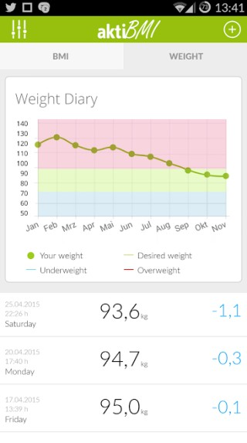
SUMMARY OF INTERACTIONS
Tracking of health and lifestyle: visualization and reports on user data over time

Slide 21

APP ADVERTISING

Slide 22
THANKS!
DO YOU HAVE ANY QUESTIONS?
The app require user feedback to continually improve
Núria, Mònica i Marta
102-09

